Slide 1

Big Mountain Resort Price Analysis

Slide 2
Problem Identification
Added new Chair lift which increased the operational cost to $1,540,000.
Identify competitive ticket price to increase revenue.

Slide 3
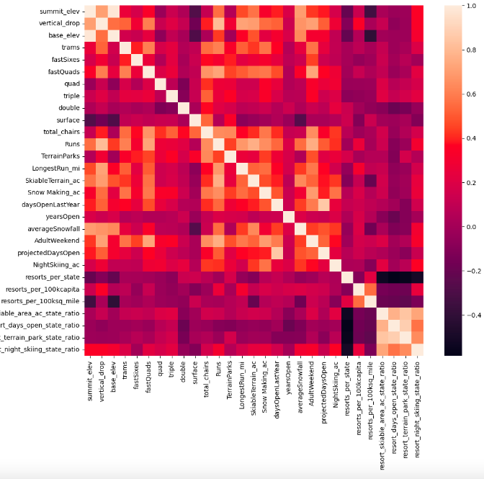
Factors that are correlated to ticket price
Top 4 features: Vertical_drop,FastQuads, Total_chairs and Runs.

Slide 4
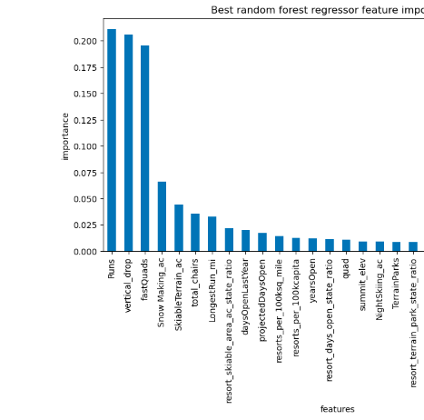
Model and Analysis
Random forest model supports the top 4 features from the correlation heat map.
Big Mountain Resort modelled price is $92.41, actual price is $81.00

Slide 5
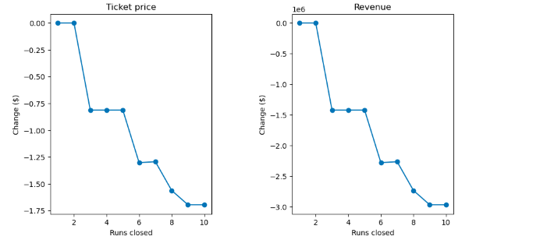
Model and Analysis
The resort can close upto 6 runs without losing a large amount in revenue.

Slide 6
Model and Analysis
Adding a run, increasing the vertical drop by 150 feet,
and installing an additional chair lift increases support for ticket price by $0.84.
Over the season, this could be expected to amount to $1468750.
Adding two more acres in the snow making area also increased the
revenue to amount to $1468750.

Slide 7
Recommendation
Raising the ticket price to $92.41.
Increase the vertical drop by 150, install addition chair lift, add additional run and increase 2 acres of snow cover.
Closing 4-6 runs each day to keep the operating cost low.

